Slide 1
Transparency - Intermediate - 1 - Philosophical concepts of Transparency

Slide 2
Being transparent
Accessible
Assessible
https://ethicsunwrapped.utexas.edu/glossary/applied-ethics

Slide 3
Transparency is contextual
Who is the information shared with?
Why is the information shared?
How should it help people make decisions?
https://www.bloomberg.com/news/articles/2017-07-09/robert-moses-and-his-racist-parkway-explained

Slide 4


Value of transparency
“Information transparency is not an ethical principle per se, seeing that it can be ethically neutral, but it can easily become an ethically ‘‘enabling’’ or ‘‘impairing’’ factor, that is a pro ethical condition, when the disclosed information has an impact on ethical principles.” (Turilli & Floridi, 2009)

Slide 5

Danger
Conversely, ethical principles can be impaired if false details (misinformation) or inadequate or excessive amounts of information are disclosed.” (Turilli & Floridi, 2009)
https://www.dictionary.com/e/misinformation-vs-disinformation-get-informed-on-the-difference/

Slide 6
Transparency and democracy
The availability of information can fuel the public debate, and helps with the process of will formation (Buijze, 2013)
The second function of transparency is that it makes it possible to observe from the outside what organisations are doing (Buijze, 2013)
Transparency around economic conditions determines how people vote .”(Hollyer et al., 2011)

Slide 7
Transparency as a political tool
Despite electoral incentives towards obfuscation, democratic governments are more likely to release policy- relevant data than are autocracies. … Whether information about a country is available is no accident. The availability, precision, and quality of data is driven, in part, by political institutions.” (Hollyer et al., 2011).

Slide 8

Trustworthiness and transparency
“Transparency has the advantage of creating certain incentives to meet required or expected standards, but that is not enough—all too often the content is not accessible, intelligible, or assessable to those with less time or knowledge”
https://www.forbes.com/sites/matthewerskine/2022/08/05/what-is-a-trust/

Slide 9
Transparency in healthcare
Trust between parties
to examine how ethical principles are applied by the party that needs to be trusted
Informed consent
for patients to decide whether to undergo a treatment;
to participate in medical research;
to establish a relationship of trust between providers of treatment/diagnosis and patient;
to have their data used to improve policy and the health system (evidenced-based healthcare and learning health systems).

Slide 10
Barrier to transparency
Six sources of opacity
Opacity from intentional secrecy
Opacity from technical illiteracy
Opacity from technological complexity
Opacity from techno-social interdependence
Opacity from application transdisciplinarity
Opacity from technology-driven processes (Herzog, 2019)

Slide 11

Responsible AI

Slide 12
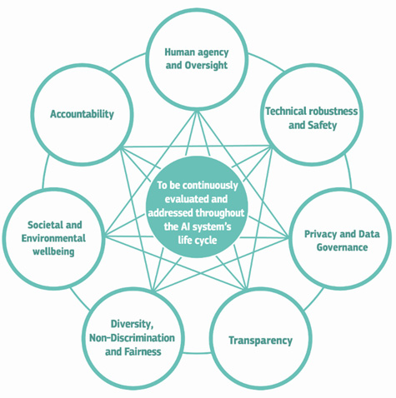
Responsible AI

Slide 13

Algorithmic Transparency Standard

Slide 14
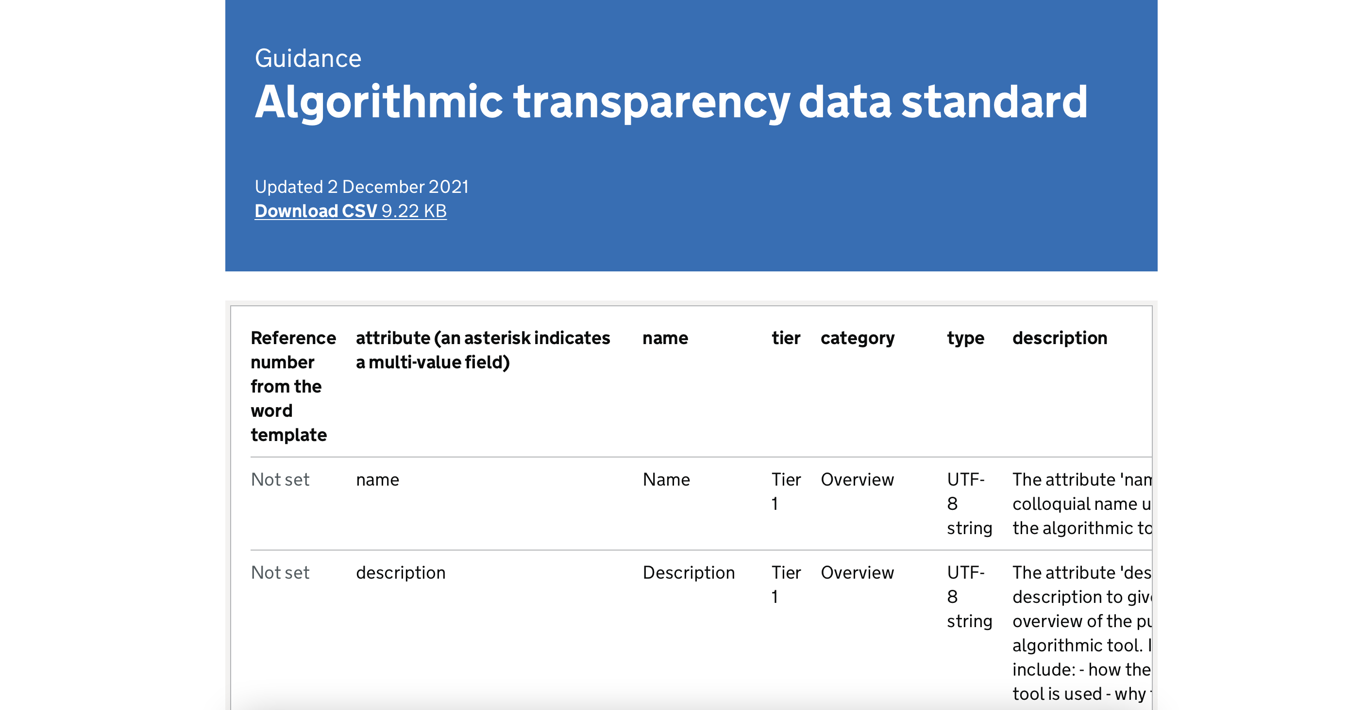
Algorithmic Transparency Standard

Slide 15
Any Questions?

